Slide 1
Facial Emotion Classification
GROUP 3
Yue Liang
Yunuo Ma
Nguyen Linh
Lingjia Zhang
yl4391
ym2774
lkn2114
lz2720
wl2727
Wannian Lou (presenter)

Slide 2
CONTENTS
01
Baseline Model: Gradient Boosting Machine
02
Data Preprocessing
03
Advanced Model: Densely Convolutional Neural Network
04
Model Comparison
05
Appendix - Other Models
Notes:
‹#›

Slide 3
Baseline model:
Gradient Boosting Machine (GBM)
01
Pros :
Accuracy: not bad
Cons :
Computationally expensive
Overemphasizes outliers and causes overfitting
Training Time(s) | 900.25
Testing Time(s) | 0.02
Testing Accuracy | 0.82
Testing AUC | 0.81
Error rate | 0.18
Final Parameters: learning_rate=0.1, n_estimators=500, max_depth=2
Notes:
Advantages:
Often provides predictive accuracy that cannot be beat.
Lots of flexibility - can optimize on different loss functions and provides several hyperparameter tuning options that make the function fit very flexible.
No data pre-processing required - often works great with categorical and numerical values as is.
Handles missing data - imputation not required.
Disdvantages:
GBMs will continue improving to minimize all errors. This can overemphasize outliers and cause overfitting. Must use cross-validation to neutralize.
Computationally expensive - GBMs often require many trees (>1000) which can be time and memory exhaustive.
The high flexibility results in many parameters that interact and influence heavily the behavior of the approach (number of iterations, tree depth, regularization parameters, etc.). This requires a large grid search during tuning.
Less interpretable although this is easily addressed with various tools (variable importance, partial dependence plots, LIME, etc.).

Slide 4
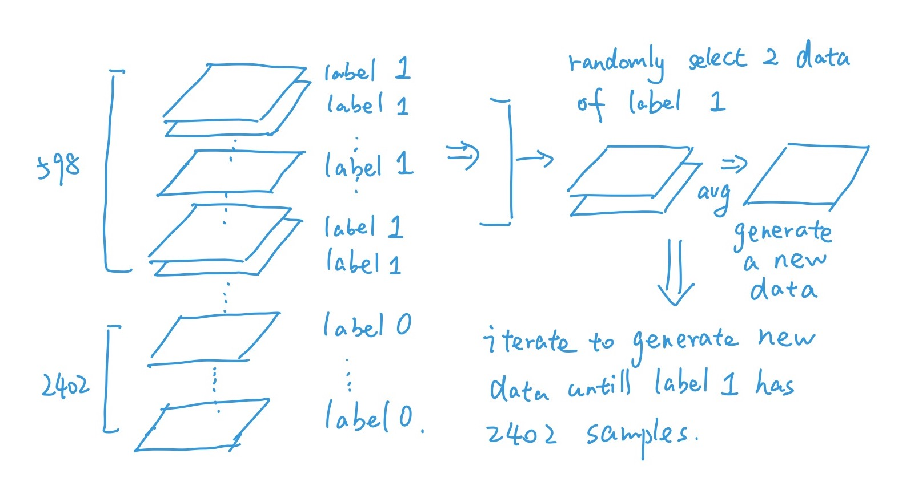
Data Preprocessing
02
Training dataset: Imbalanced (2402 of label 0, 598 of label 1)
→ Need more data w/ label 1
Process:
Randomly select 2 original coordinates of fiducial points of label 1
Average coordinates to generate new data
Calculate their pairwise distances.
Give them a label of 1
Advantages:
Balanced dataset: equal number of samples in different classes
Generated more new data --> improved the learning accuracy
Notes:
From the analysis, we found that the Original Dataset is unbalanced. So We decided to generate new data for the class with smaller number of original samples. By generating new data, we not only balanced the data with equal number of samples in different class, but also create new data to help improve the learning accuracy.
* Because the number of Class 1 samples is less than the number of Class 0 samples, we decided to add more data in Class 1.
* The way we generate more data is that we randomly select two original cordinates of fiducial points in Class 1 and average them to generate new data of fiducial points and then calculate its pairwise distances and give it the label of 1.
* It would make sense cause our models believe that the fiducial points in the same class will generate similar distribution in pairwise distances.

Slide 5
Advanced Model:
Densely Connected Neural Network
03
Pros:
High AUC and Accuracy
Less Computation time
Works well on both balanced & imbalanced dataset
Higher computational & memory efficiency
Avoid overfitting (by drop-out layers)
Cons:
Large number of parameters: 2,049,914
Dependent on vast amounts of training data
Results
Training time(s): 169.09
Testing time(s): 0.21
Testing Accuracy: 0.90
Testing AUC: 0.98
Error rate: 0.10
Notes:
Recent work has shown that convolutional networks can be substantially deeper, more accurate, and efficient to train if they contain shorter connections between layers close to the input and those close to the output. In this paper, we embrace this observation and introduce the Dense Convolutional Network (DenseNet), which connects each layer to every other layer in a feed-forward fashion. Whereas traditional convolutional networks with L layers have L connections - one between each layer and its subsequent layer - our network has L(L+1)/2 direct connections. For each layer, the feature-maps of all preceding layers are used as inputs, and its own feature-maps are used as inputs into all subsequent layers. DenseNets have several compelling advantages: they alleviate the vanishing-gradient problem, strengthen feature propagation, encourage feature reuse, and substantially reduce the number of parameters. We evaluate our proposed architecture on four highly competitive object recognition benchmark tasks (CIFAR-10, CIFAR-100, SVHN, and ImageNet). DenseNets obtain significant improvements over the state-of-the-art on most of them, whilst requiring less computation to achieve high performance.

Slide 6
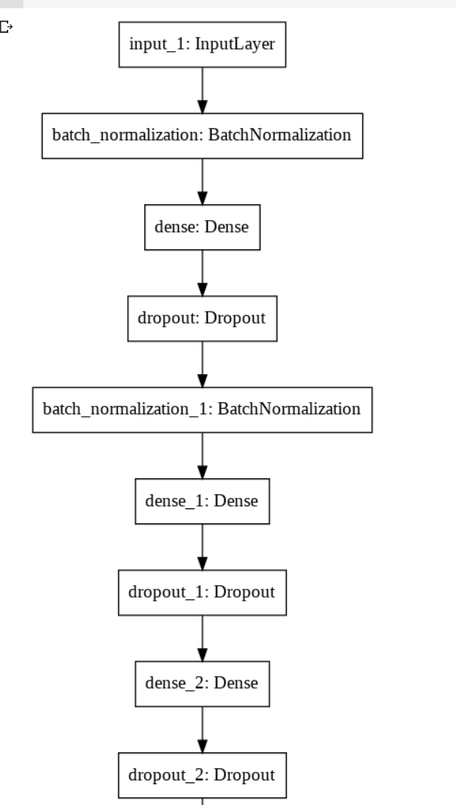
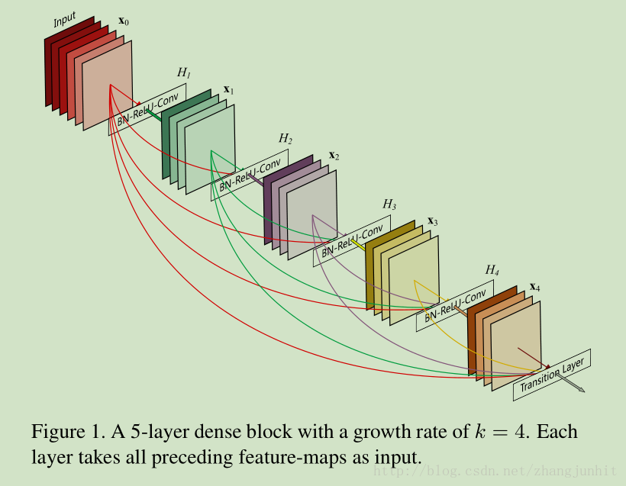
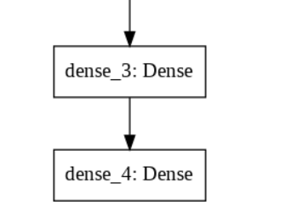
Network Structure
03
Pro:
Notes:
Higher computational efficiency and memory efficiency: each layer obtains additional inputs from all preceding layers and passes on its own feature-maps to all subsequent layers. Concatenation is used. Each layer is receiving a “collective knowledge” from all preceding layers.Since each layer receives feature maps from all preceding layers, network can be thinner and compact, i.e. number of channels can be fewer.
Recent work has shown that convolutional networks can be substantially deeper, more accurate, and efficient to train if they contain shorter connections between layers close to the input and those close to the output. In this paper, we embrace this observation and introduce the Dense Convolutional Network (DenseNet), which connects each layer to every other layer in a feed-forward fashion. Whereas traditional convolutional networks with L layers have L connections - one between each layer and its subsequent layer - our network has L(L+1)/2 direct connections. For each layer, the feature-maps of all preceding layers are used as inputs, and its own feature-maps are used as inputs into all subsequent layers. DenseNets have several compelling advantages: they alleviate the vanishing-gradient problem, strengthen feature propagation, encourage feature reuse, and substantially reduce the number of parameters. We evaluate our proposed architecture on four highly competitive object recognition benchmark tasks (CIFAR-10, CIFAR-100, SVHN, and ImageNet). DenseNets obtain significant improvements over the state-of-the-art on most of them, whilst requiring less computation to achieve high performance.

Slide 7
Comparison:
Baseline vs. Advanced
04
Metrics\Models | Baseline Model on Imbalanced dataset | Baseline Model after data preprocessing | Advanced Model after data preprocessing | Advanced Model testing on Imbalanced dataset
Training Time(s) | 900.25 | 1123.2 | 169.1 | -
Testing Time(s) | 0.02 | 0.02 | 0.60 | 0.51
Testing Accuracy | 0.82 | 0.85 | 0.91 | 0.91
Testing AUC | 0.81 | 0.93 | 0.98 | 0.98
Error rate | 0.18 | 0.15 | 0.09 | 0.09
Notes:
Balancing the data set improved accuracy from 0.82 to 0.85, and AUC from 0.81 to 0.93¶
Advanced model works well for both imbalanced and balanced data set

Slide 8
APPENDIX -
OTHER MODELS USED

Slide 9
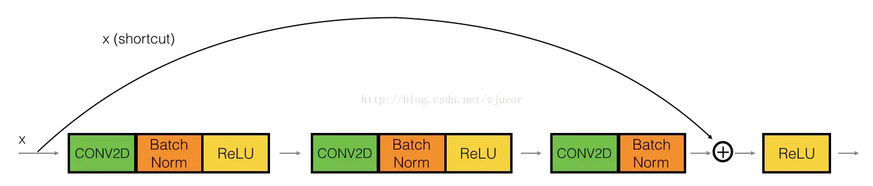
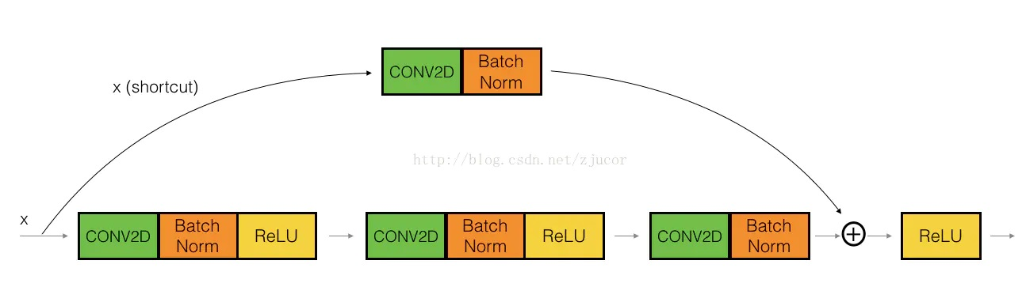
Convolutional Neural Network (Resnet50)
01
An identity mapping of x is added in the ordinary convolution process
Identity Block：
Conv Block：

Slide 10
Convolutional Neural Network (Resnet50)
01
Pros:
High AUC
Easier to optimize
Can gain accuracy from increased depth
Cons:
Low time and computational efficiency
Doesn’t improve accuracy vs. baseline
Results:
Training time(s): 1877.7
Accuracy: 0.82
AUC: 0.9

Slide 11
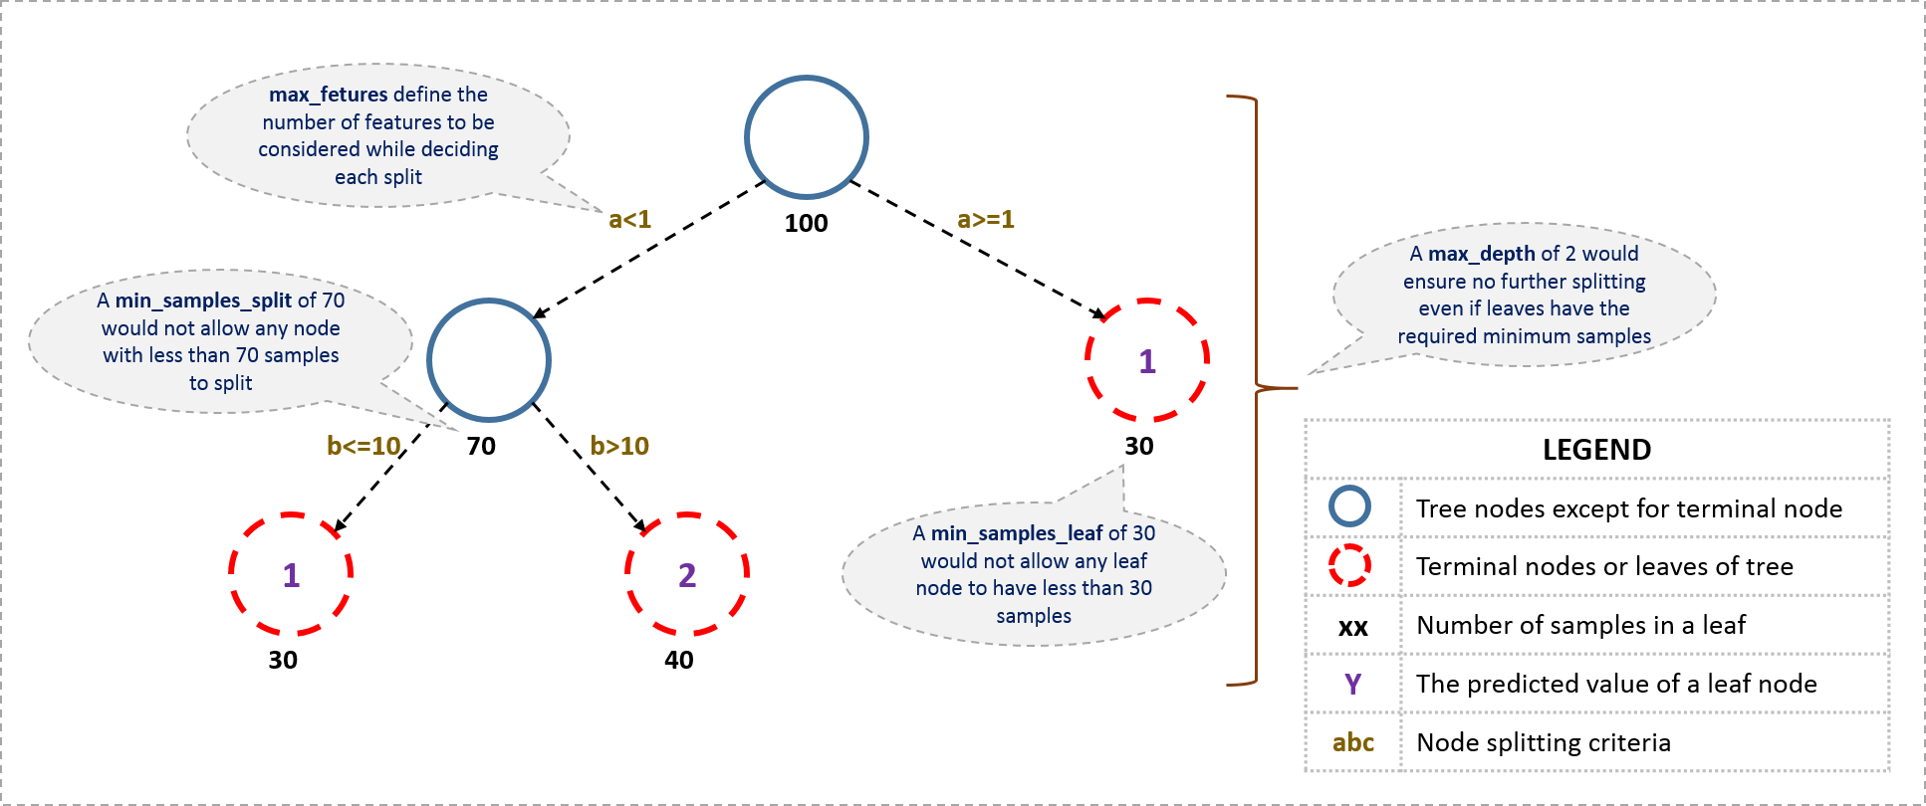
GBDT
02
Training time(s): 73.2
Accuracy: 0.90
AUC: 0.96

Slide 12
Random Forest
03
Pros :
Training speed: fast
Easy to make a parallel method
Influence between features can be detected
Cons :
Large space and time required for large # of decision trees
Results:
Training time(s): 259.2
Accuracy: 0.87
AUC: 0.77

Slide 13
SVM & KNN
04
Standard SVM Results
Training time(s): 278.7
Accuracy: 0.52
AUC: 0.52
Weighted SVM Results
Training time(s): 59.2
Accuracy: 0.78
AUC: 0.79
KNN Results
Training time(s): 2.32
Accuracy: 0.73
AUC: 0.73
SVM:
Pros:
Simplify high-dimensional space problems, fast training time
Cons:
Cannot deal with large dataset
Low accuracy and AUC
KNN:
Pros:
Mature theory, simple model
Low complexity
Fast training time
Cons:
Large # of calculations with large # of features

Slide 14
XGboost
05
Pros :
Accuracy: not bad
Flexible, only the first and second derivatives of loss function are required
Cons:
Many leaf nodes have low split gains, so there is no need for further splits
Results:
Training time(s): 1464
Accuracy: 0.8483
AUC: 0.841

Slide 15


Model Summary
Metrics\Models | Baseline GBM | Advanced DCNN | GBDT | LR | ResNet | Weighted SVM | KNN | XGBoost | Random Forest
Training Time(s) | 900.2 | 169.1 | 73.2 | 14.3 | 1877.7 | 59.2 | 2.2 | 1,464.0 | 259.2
Accuracy | 0.82 | 0.91 | 0.90 | 0.85 | 0.82 | 0.78 | 0.73 | 0.85 | 0.81
AUC | 0.81 | 0.98 | 0.96 | 0.92 | 0.90 | 0.79 | 0.73 | 0.84 | 0.78
Notes:
‹#›

Slide 16
References
Weighted SVM: https://machinelearningmastery.com/cost-sensitive-svm-for-imbalanced-classification
Dense NN:
https://heartbeat.fritz.ai/classification-with-tensorflow-and-dense-neural-networks-8299327a818a
https://digitalcommons.northgeorgia.edu/cgi/viewcontent.cgi?article=1036&context=honors_theses
ResNet50:
https://github.com/keras-team/keras-applications/blob/master/keras_applications/resnet50.py
Past projects: https://github.com/TZstatsADS/Spring2020-Project3-group1

Slide 17
Thank you for listening!
GROUP 3
Notes:
‹#›

